Slide 1
Pay As You Ride METROBIKE TRIPS
BIKE BIKE
A U S T I N
INVESTIGATION OF
INVESTIGATION OF
Ava Lim, Amanda Zhang, and Zoe Ly
RIDE RIDE RIDE
Notes:
zoe

Slide 2
Our Motivations
BIKE BIKE
Large presence in Austin
Explore how the bikes are used
Fairly accessible and inexpensive mode of transportation
Seen all over the city and UT campus
Interested in understanding user preferences
Want to identify trends that allow for better allocation of resources or optimize user needs
RIDE RIDE

Slide 3
Cleaning and Formatting our Data
Variables
Formatting
Trip Id (Each MetroBike trip has an individual identifier number),
Bike Id (Each bike’s id number),
Trip Duration (How long each bike trip is in minutes),
Day Type (The type of day on which the trip occurred -either a weekday or a weekend),
Checkout Time (The hours, minutes, and seconds that a bike was checked out for a trip),
Bike Type (The type of bike used - either classic or electric),
Season (The date used split into Fall/Winter/Spring/Summer), and
Year (The year the bike trip occurred)
Season
Checkout Time
Day
Cleaning
Filtered for Single Trip Data (Pay as you Ride Single Trip)
No NA values!
Original Dataset had 14 columns, we selected 8 of them. 35320 Observations Total
Notes:
Originally 14 variables, cleared it to 8 b/c of repeat/duplicate or unnecessary data, or too many categories. The variables we had to change were season - use from the month variable, Checkout Time, which we converted from the hh:mm:ss format to hours, and Day, which we originally had as the 7 days of the week, but to cut it down to 4- categories, we changed it to Weekday Vs Weekend. Luckily, when we looked at our final dataset, we found that coincidentally there were no NA values we had to consider.

Slide 4
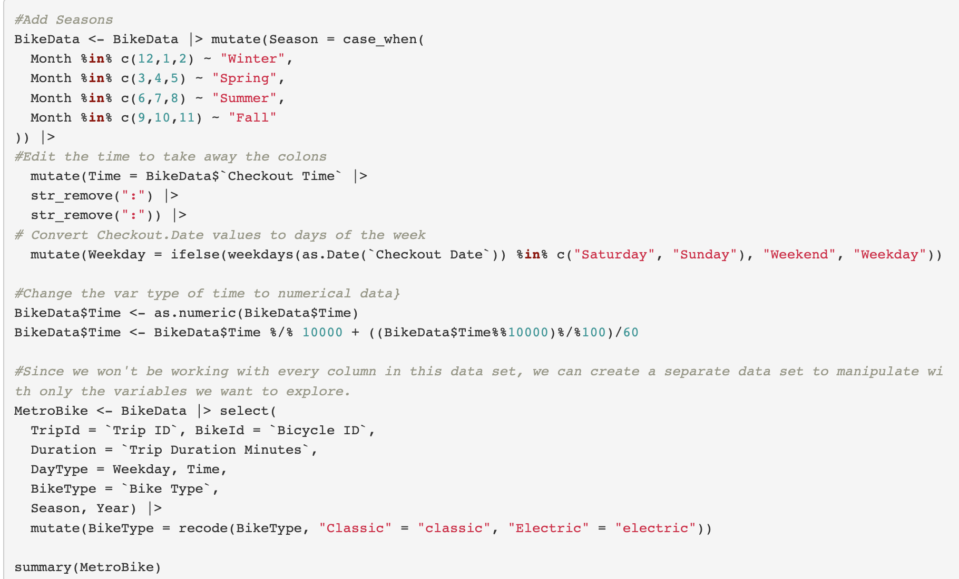

Slide 5
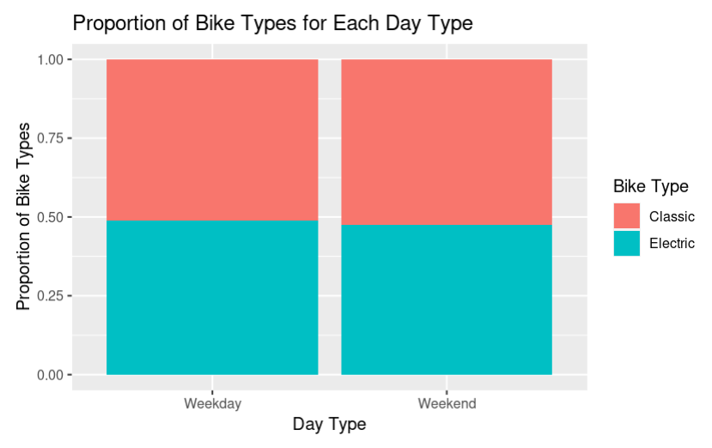


Is there a relationship between the type of bike used and the type of day in which the trip occurred?
Frequencies of Bike Types Per Day Type
Proportions of Bike Types Per Day Type
There seems to be no relationship between the type of bike used and the type of day on which the trip occurred.
Notes:
Change we to I’s >> report
Put research question in context or no
Edited takeaways and article context and citations, ethical concerns???, and my results
Str_remove source
Weekdays/as.date source

Slide 6
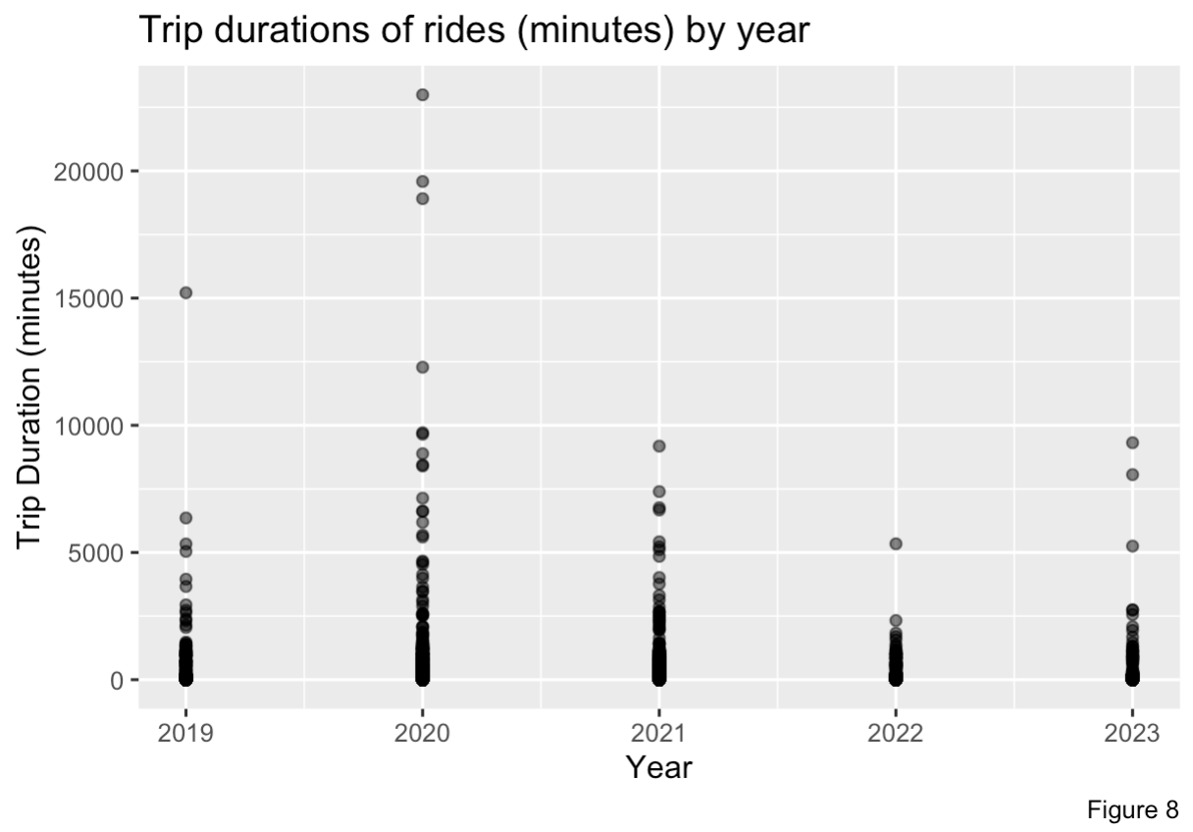
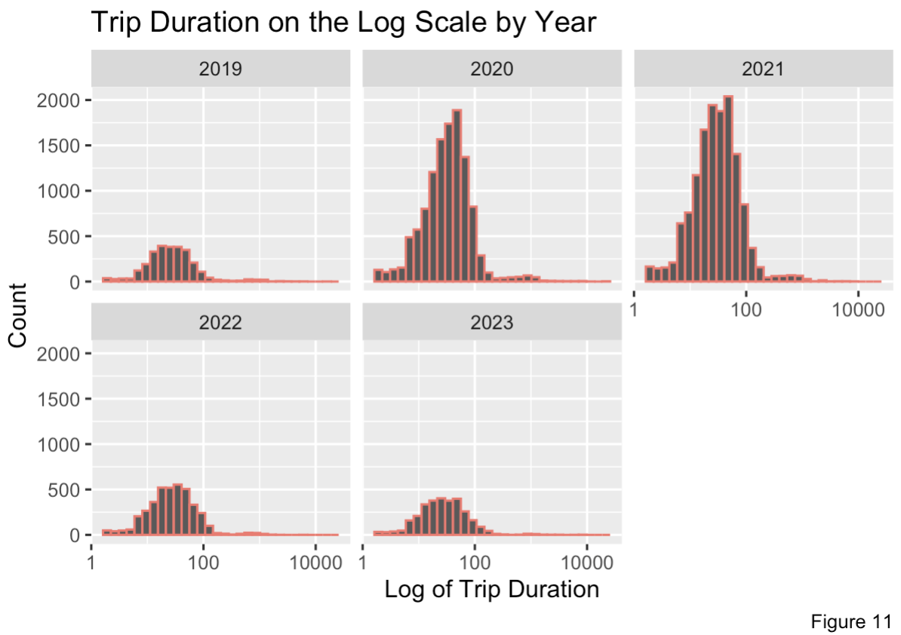
Is there a relationship between the year a trip occurred and its length?
There seems to be a relationship between Year and Trip Duration, as the spread of Trip Duration is noticeably larger in the years 2020 and 2021.
Note that this relationship is not linear, and that with 5 discrete years, Year could be considered as either a numeric or categorical variable.

Slide 7
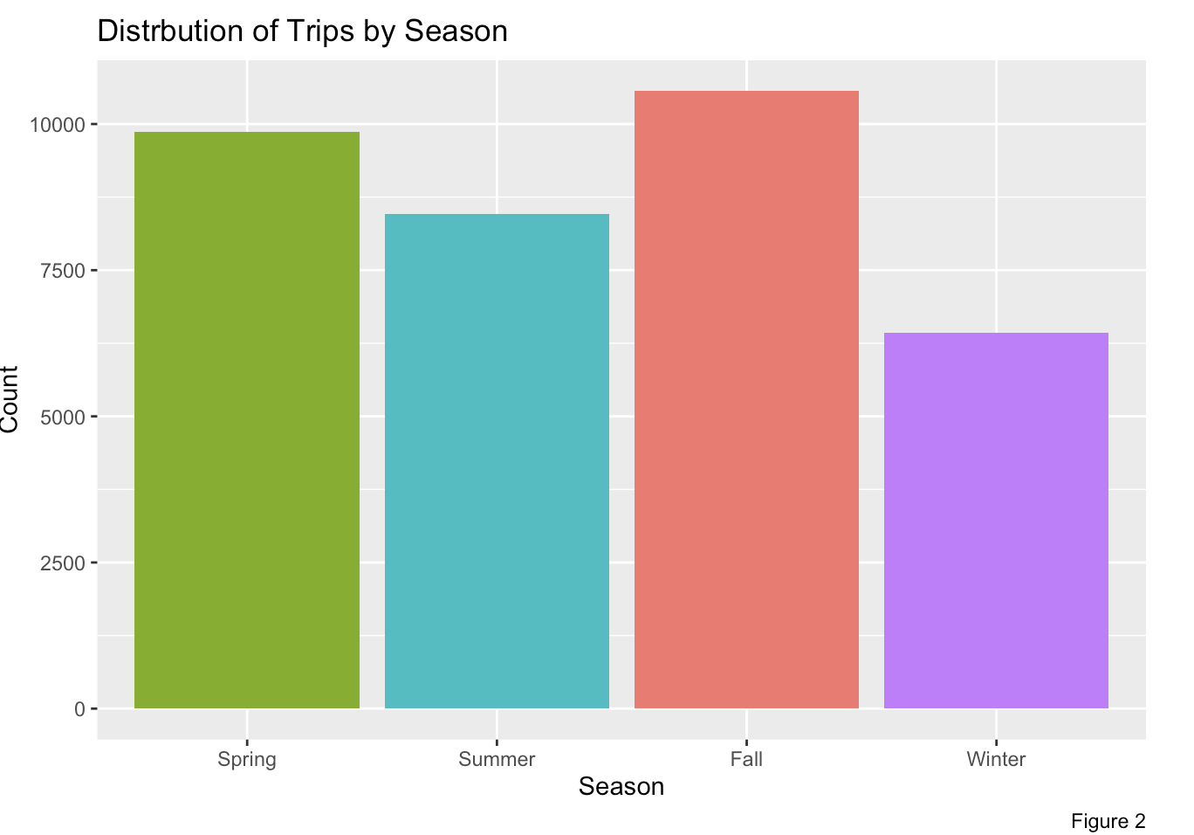
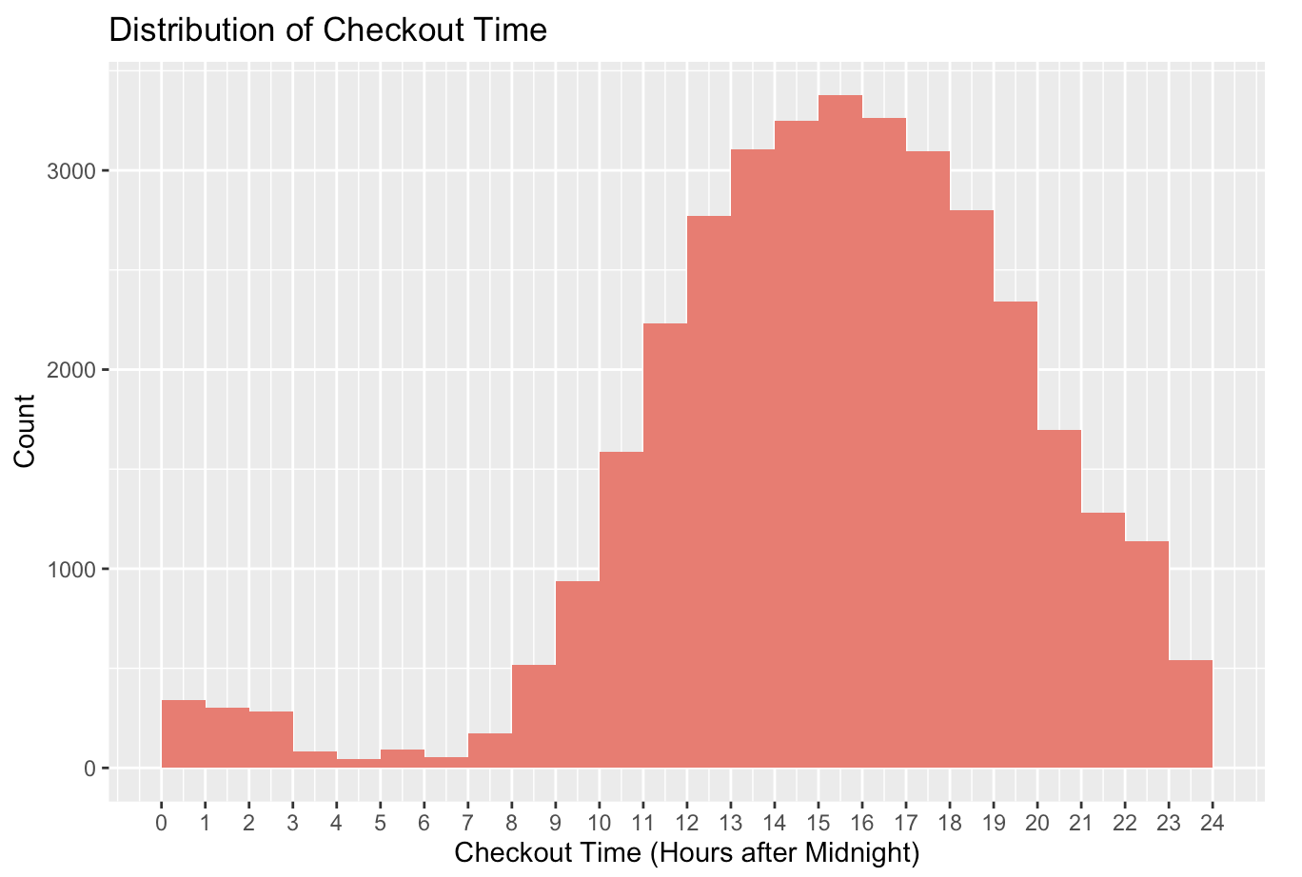
Is there a relationship between the Season and Checkout Time of every trip?
These distributions of Season and Checkout Time follow a pretty expected distribution that can be explained logically.
RIDE RIDE RIDE

Slide 8
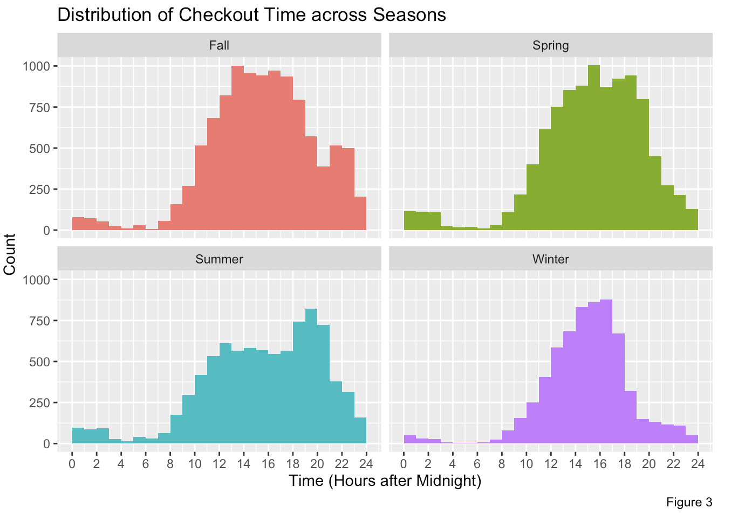
(cont.) Some relationship between Season and Checkout Time
Although the distribution across seasons follows mainly the same shape or distribution, we can see how each season has its own details and unique points, especially winter.

Slide 9
Conclusion!
Pay as You Ride Single Trips
Whether a trip occurs on a weekend or weekday most likely does not influence the proportion of classic or electric bikes used in a day, though we can conclude that checkout times tend to be earlier in the day in Winter months, and that the year during which a ride took place can affect its duration based on this dataset.

